Slide 1
Face Recognisation Six weeks Industrial Training Report at Ducat Institute Submitted by:- Student Name:-Kritika Pandey DEPARTMENT OF COMPUTER SCIENCE & ENGINEERING Mahaveer Swami Institute Of Technology 2017

Slide 2
INDEX
Introduction to concept of face recognisation
Technologies Used
Hardware and software used
Coding
Cmd
Flow chart
Output
Conclusion
Future work

Slide 3
Introduction to concept of face recognisation
Humans are very good at recognizing faces and complex patterns. Even a passage of time doesn't effect this capability and therefore it would help if computers become as robust as humans in face recognition. Face recognition system can help in many ways :
1) Checking for criminal records .
2) Enhancement of security by using surveillance cameras in conjunction with face recognition system.
3) Finding lost children's by using the images received from the cameras fitted at some public places .
4) Knowing in advance if some VIP is entering the hotel.
5) Detection of a criminal at public place.
6) Can be used in different areas of science for comparing a entity with a set of entities.
7) Pattern Recognition.
This project is a step towards developing a face recognition system which can recognize static images. It can be modified to work with dynamic images. In that case the dynamic images received from the camera can first be converted in to the static one's and then the same procedure can be applied on them. But then there are lots of other things that should be considered. Like distance between the camera and the person, magnification factor, view [top ,side, front] etc

Slide 4
Product Description
The Face Detection will locate faces in a given image and separate them from the scene. The extracted faces will be further transformed using processing techniques like grayscale transformation, histogram equalization.
Product Features
The Face Recognition System will recognize faces provided by the detection module. It will use the Eigenfaces algorithm for recognition and Principal Component Analysis for dimensionality reduction. The training phase needs a subjects database – each person should have a different folder (unique folder name – ID) with more face pictures in different rotation and lighting conditions. The recognition module will return a list of IDs for the recognized persons, IDs used to extract information from the MySQL database.
Security level users
Bank Manager- this is the sophisticated user which is having some knowledge about system and handle the privilege for the different types of users.
Administrator- this apply the different types of security policies over the system to increase the robustness of the system.

Slide 5
Design and Implementation Constraints
It will needed windows environment. It will not work on linux platform. The 128MB minimum RAM is required for the system to use. It will only work on single pc not on the network.
User Documentation
The on-line help is required for the users so that they can use the system properly. The tool tip text is also being provided for the knowledge of the every function.
System Features
This section illustrates the functional features of the system. It gives the total description about the system functionalities that are provided by the system. The features are described below:-
User name and password feature
Description and Priority
This is the important feature of the system. Every user must have user name and password for using the system. This feature has the highest priority.
Stimulus/Response Sequences
After correctly entering the user id and password a new screen will be opened for the user according to their privileges. After entering the wrong user id and password this will be give message as a dialog box.
Stimulus/Response Sequences
In this feature the employee creates the customer account by filling up the form of creating account if any information is wrongly written then it will show the message. If the information is correctly entered then the software show information of account created on the next screen that the account is created.
Due Record
Description and Priority
This feature include the managing the customer which don’t pay their installment at proper time. When employee want to see the due installment customer they see the list from this. This has high priority.

Slide 6
Technologies Used
Model:
Core Java
Swing
Events
Notepad
Utilities
Design
Swing
Awt
Database
Oracle 10g

Slide 7
Hardware & Software Used
Software used
Operating System : Window 7
Front End : Notepad
Back End : Oracle 10g
Language Used : JAVA
Hardware Requirements
Machine : Intel core i3
Speed : 2.5 GHz and above
Hard Disk : 500GB
RAM : 4GB

Slide 8
Coding
Home page.java
login java
Register.java
Sound clip.java
These are coding pages for login, registry and database connectivity

Slide 9
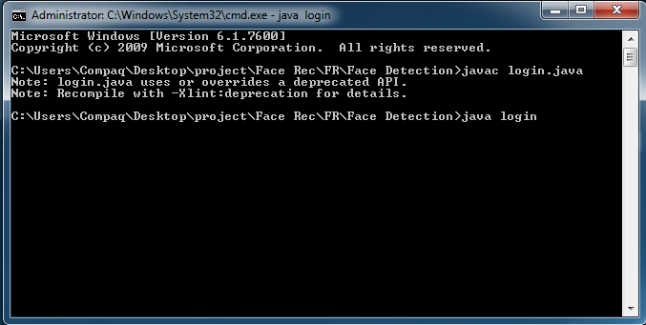
cmd

Slide 10
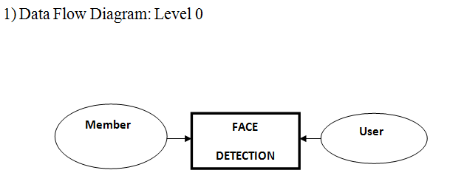
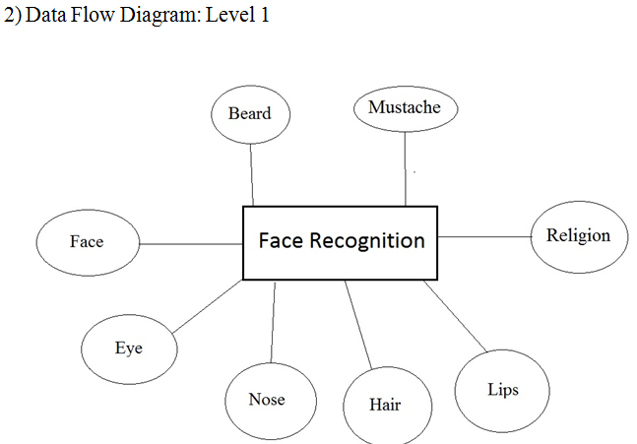
FLOWCHART

Slide 11
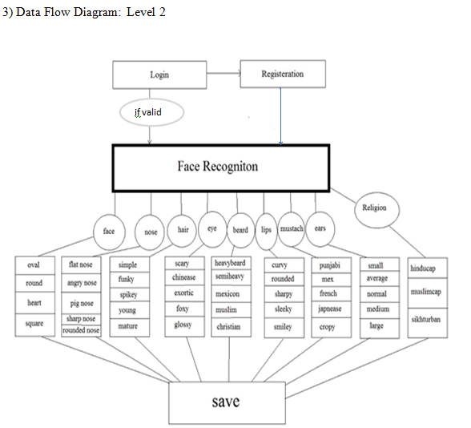

Slide 12
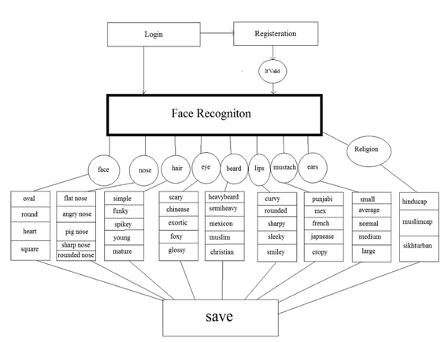

Slide 13
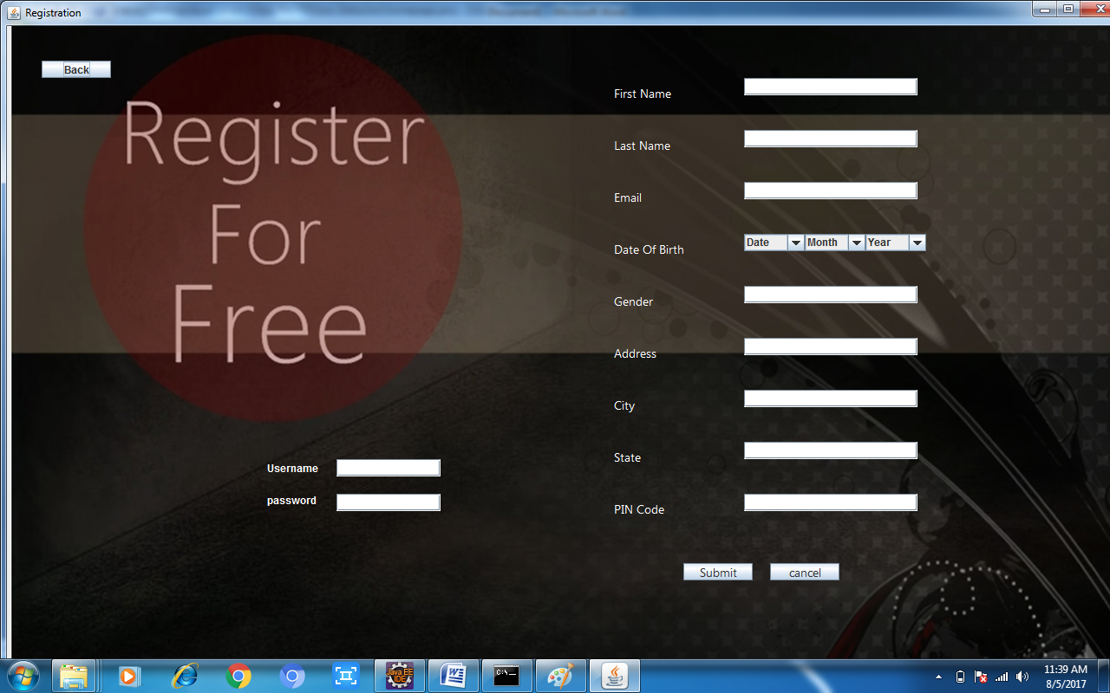
OUTPUT

Slide 14
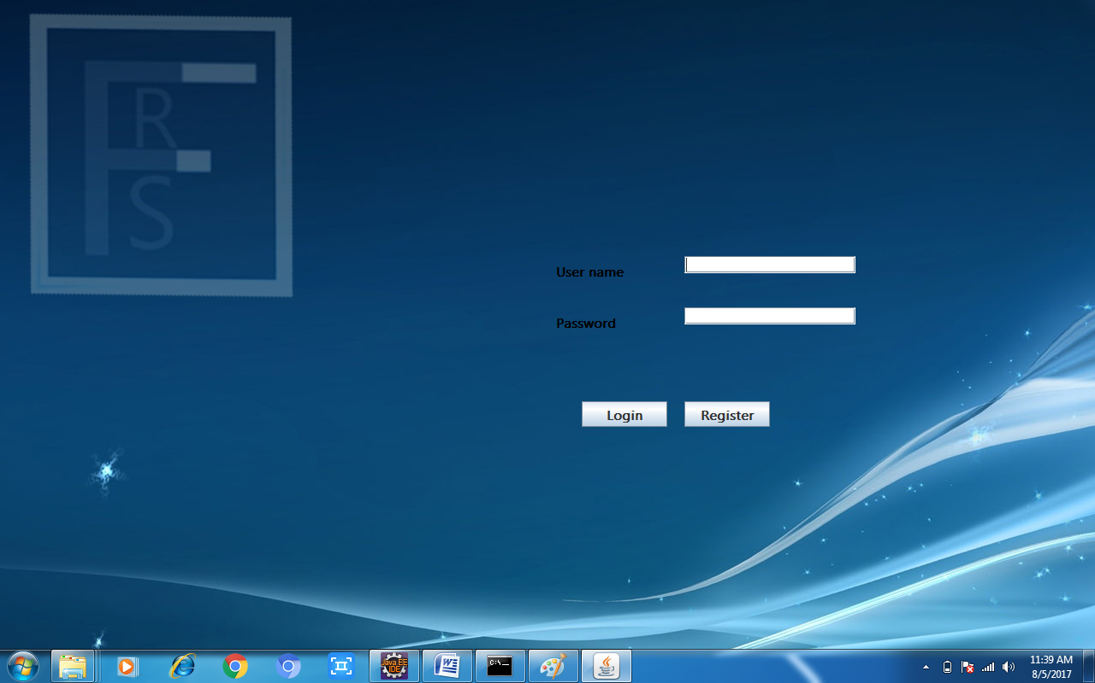

Slide 15
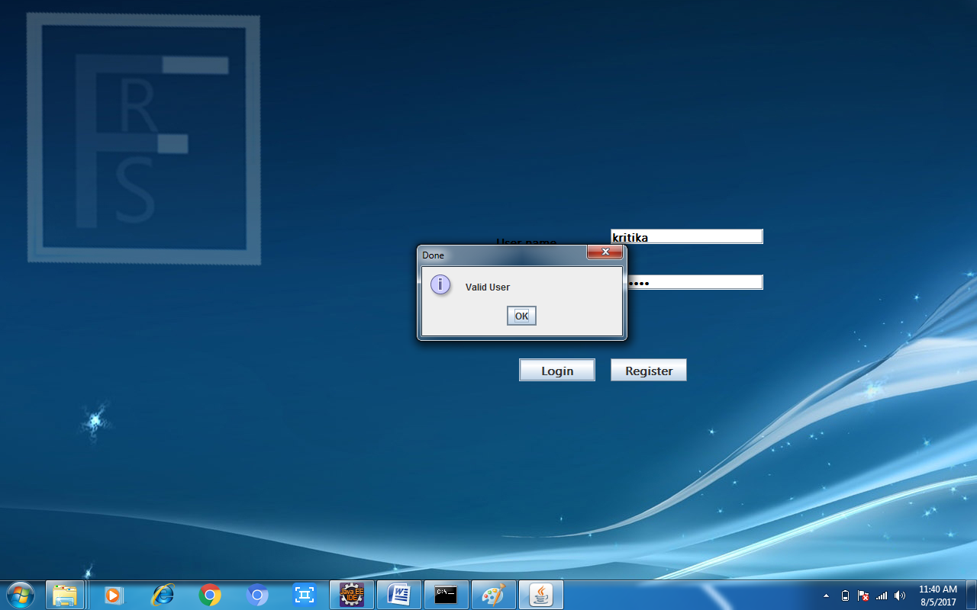

Slide 16
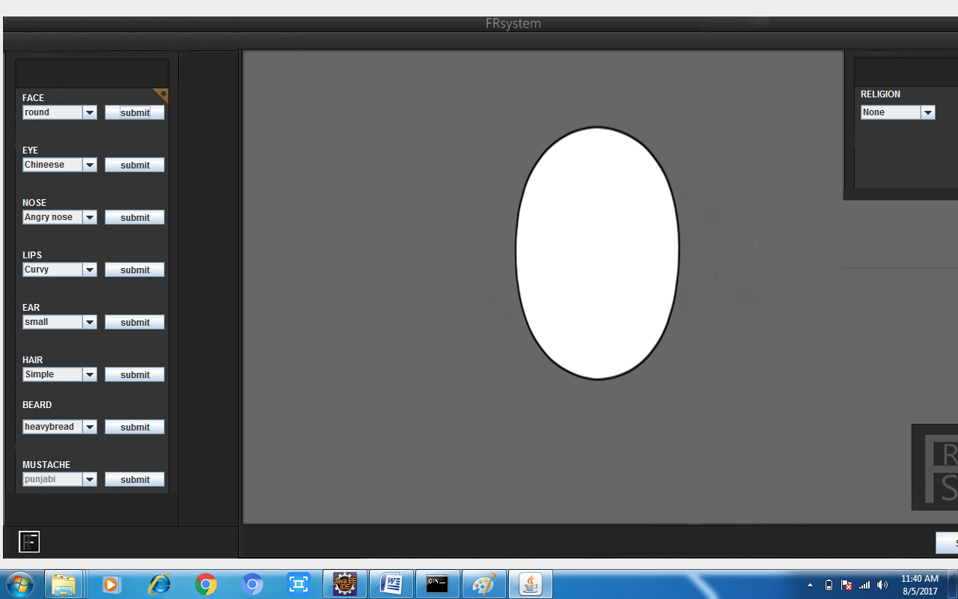

Slide 17
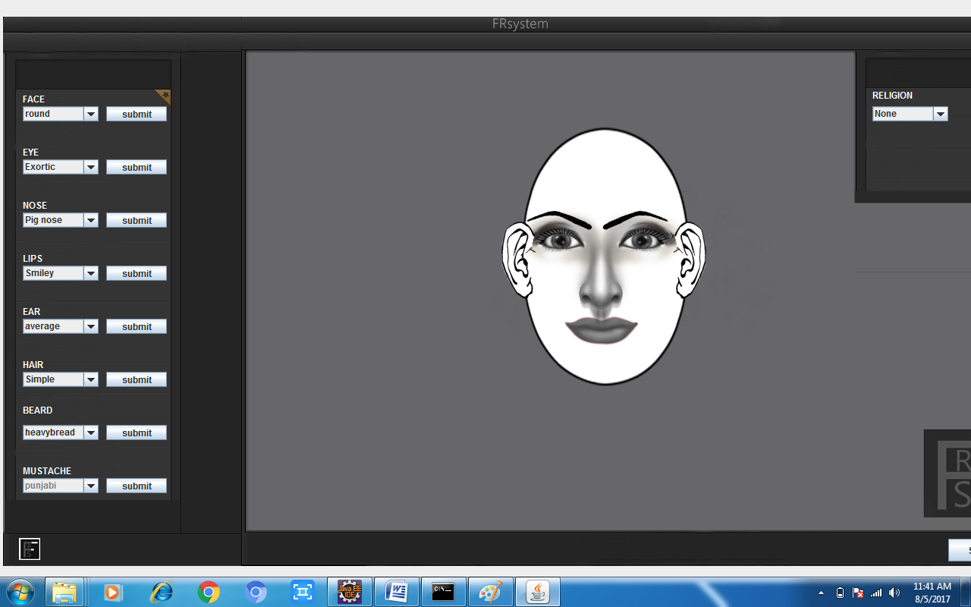

Slide 18
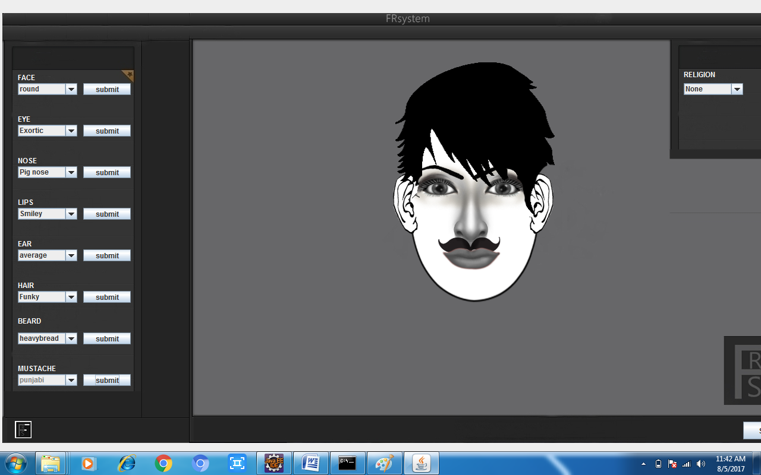

Slide 19
Conclusion
The system has been developed for the given condition and is found working effectively. The developed system is flexible and changes whenever can be made easy. Using the facilities and functionalities of Java, the software has been developed in a neat and simple manner, thereby reducing the operators work
Need Of FR Management
Nearly 60% of the State total budget is spent towards Salary & Allowance of Employees.
Finance department use to take nearly 4 months to collect and consolidate these data.
It was laborious, time consuming still accuracy of data was in question.
Therefore it was thought of computerizing this activity.
During course of the discussions, it was planned to computerize the entire Face Recognition.
World Bank funded this project.
The total estimation of the project was 5 crores
Limitations of Manual System
Service records and payroll details are maintained in papers and are decentralized.
Information about these employees has to be culled out from these Service registers and needs consolidation.
Decision making is time consuming
There is no uniformity in payroll generation
Gives scope to errors and fraud
No proper security to the data
Non reaching of Rules/G.O leading to Inconsistency in implementation of Service rules

Slide 20
FUTURE WORK
This is a basic app structure which maintains security which can be enhanced in future
It can be used in banks specially to keep identification of its members
Here it lacks in variation as only litmited faces could be made but in millions of people every person is different in order to conquer that problem further enhancement can be done to project

Slide 21
Presented by :- Kritika Pandey B.Tech –CSE 40155102715 5 th sem (3 rd year)
Thank -you

